Slide 1

Shenandoah
Intro to Red Hat’s Shenandoah Garbage Collector
Notes:
chf@redhat.com; zgu | roman. Used to be Red Hat’s Shenandoah, now is (amazon generational) Shenandoah. This presentation takes about 30min total.

Slide 2
Overview
Always improving
Usage | Shenandoah Summary
Shenandoah vs G1GC
Shenandoah Building blocks & Algorithm
Overview phases simplified
Shenandoah Phases
Shenandoah Features
Modes/Heuristics/Failure Modes
Traversal Mode [deprecated]
Tuning
Logs vs Interpreting logs
Containers
New in JDK 17
Extra: Shenandoah Visualizer
Relevant Cases & Relevant Solutions
References
Additional information
Notes:
Jdk 1.8.232

Slide 3
Usage
Just add the flag -XX:+UseShenandoahGC and you’re good to go
Example:
/home/cases/java-11-openjdk-11.0.9.11-2.portable.jdk.el.x86_64/bin/java -XX:+UseShenandoahGC -Xlog:gc*=trace:file=gc.log TestObjectStreamClass
Notes:
Jdk 1.8.232

Slide 4
Shenandoah Summary (algorithm Shenandoah2 described below)
Concurrent → the application runs together with the GC
Location based GC - Forwarding pointers enable Shenandoah to collect each region independently without remembered sets.
Not generational based (this means the log does not have Young, Terenure, Old) → don’t look for young gen on the logs
Operates in 3 or 2 concurrent phases (deprecated traversal operates in one concurrent mode)
Can be used in OpenJDK 1.8 & OpenJDK 11 & OpenJDK 17
Shenandoah compacts concurrently.
> 10ms (ZGC Oracle - soft goal)
Notes:
[][][][] [x][x][x][]
[][][][] → [x][][][] x → objects
[][][][] [][][][]

Slide 5
Comparing with G1 Garbage Collector
G1 Garbage Collector: Generational GC
Shenandoah divides the heap into regions, so it is called a regionalized GC. Those regions have separated threads, working at the same time, which improve the performance. Shenandoah2 has smaller footprint compared to other GCs
G1GC: divides the heap and associates the regions to generations not continuously. But similar number of regions more or less.
Comparison between G1GC vs Shenandoah on this solution
Notes:
Be careful out there, you might find links saying footprint is big on shenandoah, that’s actually not true anymore no more additional word for forwarding pointer.

Slide 6
Shenandoah Building Blocks
Level of indirectness → Brook’s pointer →used to be an additional word (plus the other two) now it uses the forwarding pointer in the header word
Snap shot at the Beginning - SATB (normal/stab mode) (also used by G1 GC): which takes a snapshot of the set of live objects in the heap at the start of a marking cycle.
Notes:
Please be careful when reading because the paper (JJJP 2016) is the shenandoah v1, which has

Slide 7
Shenandoah Algorithm
Heap divided into equal regions (similarly to G1GC)
Concurrent marking keeps track of live data in each region
GC threads pick the regions with the most garbage to join the collection set
GC threads evacuate live objects in those regions (evacuates, not evaluates)
Subsequent concurrent marking updates all references to evacuated regions
Evacuated regions reclaimed
Update references

Slide 8
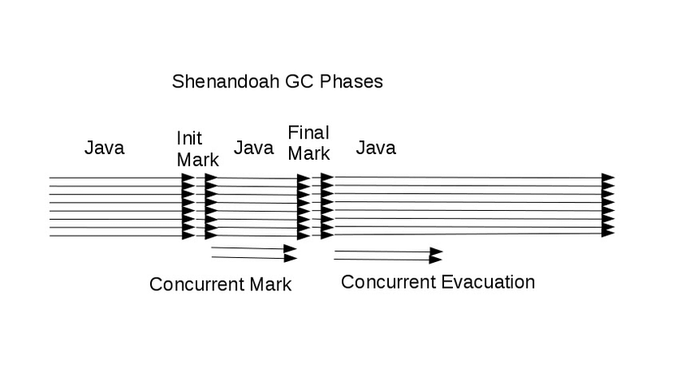
Overview: Phases simplified
Concurrent Marking (stab → snapshot of the set of live objects)
Concurrent evaluation
Concurrent update references (optional)
Notes:
Snap shot at the beginning

Slide 9
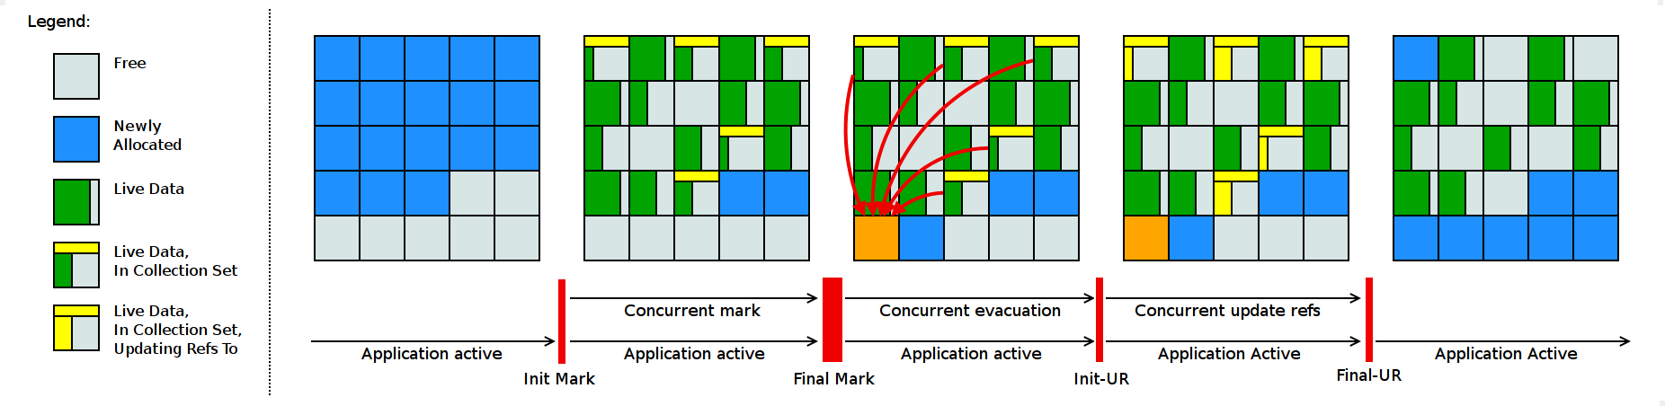
Basic Algorithm - with 3 concurrent phases
Concurrent
Mark
Evaluation
Update refs

Slide 10
Complete Phases
The phases above do roughly this:
Init Mark
Concurrent Marking
Final Mark
Concurrent Cleanup
Concurrent Evacuation.
Init Update Refs
Concurrent Update References
Final Update Refs
Notes:
Complete phases

Slide 11
Shenandoah Features
Pauses only long enough to scan root set (in JDK 17 ms pauses)
Concurrent and parallel marking ← concurrent
Concurrent and parallel evacuation ← concurrent
No card tables or remembered sets ← no external tables as well, small footprint
Notes:
Shenandoah Features

Slide 12
Modes
normal/satb default~ snap-shot at the beginning (stab) marking
ui ~ experimental
passive ~ diagnostics
Notes:
Shenandoah Heuristic

Slide 13
Heuristics
Static heuristic ~ First then if we set a goal, as in a hard set percentage, like 50%, and stick with that . But this can be too pessimistic, meaning you clean too much in advance from the actual application usage == heap occupancy.
This heuristics decide to start GC cycle based on heap occupancy.
Adaptive heuristic ~ still used ~ It sets some boundaries but adapts according to the application usage of the memory. There are three options in case the application is filling faster than cleaning.
Notes:
Shenandoah Heuristic

Slide 14
Failure modes: Degenerated state vs Full GC
Basically Shenandoah is a run to clean more memory than the application is generating - a concurrent GC. But sometime you start to lose this race, so then first you start to clean everything but still with the threads running, and if still does not work, so then you stop everything to clean the heap. So then:
Pacing: First it will pace the application allocation → up to a certain ShenandoahPacingMaxDelay (default max is 10ms)
Degenerative GC ~ STW occurs together with the concurrent cycle. It can turn to Full GC if the concurrent gc do not happen (if a failure is detected after some phase) → yes
Full GC/ STW - Finally as the last resource it can be used to avoid an OOME - which can be the case for ZGC. Stop everything, including the concurrent threads, and clean the heap.
Pacing
DegenerativeGC
FullGC
Notes:
Failure modes

Slide 15
Traversal Mode [deprecated] (the concurrent tasks happen in one phase)
The phases above do roughly this:
Init Mark
2. Concurrent Marking
2. Concurrent Cleanup
2. Concurrent Evacuation.
2. Concurrent Update References
Final Update Refs
Consult Solution https://access.redhat.com/solutions/5487471
Notes:
Deprecated → Traversal Mode

Slide 16
Tuning Shenandoah
Options:
Triggers: heap % or phases (in case of default)
Change heuristic ← make sure you know what you are doing
Select a different Mode ← passive for diagnostics
Change pace
Set a different ShenandoahMinFreeThreshold
Comments:
Avoiding -Xms = -Xmx to use lower footprint - otherwise it will set xmx as the baseline
Consult solution https://access.redhat.com/solutions/5242021
Notes:
Tuning shenandoah

Slide 17
Shenandoah Logs
OpenJDK 64-Bit Server VM (25.302-b08) for linux-amd64 JRE (1.8.0_302-b08), built on Jul 17 2021 18:13:18 by "mockbuild" with gcc 4.8.5 20150623 (Red Hat 4.8.5-44) Memory: 4k page, physical 15908268k(2468964k free), swap 8388604k(8186876k free) CommandLine flags: -XX:CompressedClassSpaceSize=260046848 -XX:GCLogFileSize=3145728 -XX:InitialHeapSize=1366294528 -XX:MaxHeapSize=1366294528 -XX:MaxMetaspaceSize=268435456 -XX:MetaspaceSize=100663296 -XX:NumberOfGCLogFiles=5 -XX:+PrintGC -XX:+PrintGCDateStamps -XX:+PrintGCDetails -XX:+PrintGCTimeStamps -XX:-TraceClassUnloading -XX:+UseCompressedClassPointers -XX:+UseCompressedOops -XX:+UseGCLogFileRotation -XX:+UseShenandoahGC Regions: 2606 x 512K Humongous object threshold: 512K Max TLAB size: 65536B GC threads: 4 parallel, 2 concurrent Heuristics ergonomically sets -XX:+ExplicitGCInvokesConcurrent Heuristics ergonomically sets -XX:+ShenandoahImplicitGCInvokesConcurrent Shenandoah GC mode: Snapshot-At-The-Beginning (SATB) Shenandoah heuristics: Adaptive Pacer for Idle. Initial: 26685K, Alloc Tax Rate: 1.0x Initialize Shenandoah heap: 1303M initial, 1303M min, 1303M max Reference processing: parallel discovery, parallel processing Trigger: Learning 1 of 5. Free (911M) is below initial threshold (912M) Free: 911M, Max: 512K regular, 911M humongous, Frag: 0% external, 0% internal; Reserve: 67072K, Max: 512K 2021-10-12T22:59:35.102-0400: 1.629: [Concurrent reset, start] Using 2 of 4 workers for concurrent reset

Slide 18
Interpreting Shenandoah Logs
Enable GC logs with details:
-Xlog:gc (OpenJDK 11) or -verbose:gc (up to JDK 8) would print the individual GC timings.
-Xlog:gc+ergo ( OpenJDK 11) or -XX:+PrintGCDetails (up to JDK 8) or would print the heuristics decisions, which might shed light on outliers, if any.
-Xlog:gc+stats ( OpenJDK 11 ) or -verbose:gc (up to JDK 8) would print the summary table on Shenandoah's internal timings at the end of the run.
Verify the time spent on each phase ( concurrent marking, concurrent evaluation, concurrent reference update)
Regions: 2606 x 512K
See Humongous threshold
Using 2 of 4 workers for concurrent reset
Consult solution https://access.redhat.com/solutions/5332661

Slide 19
Containers
Shenandoah is not generational yet*,
Therefore this can have a high throughput losses;
Consider it wisely for Containers (in comparison with others) but better than G1GC!
The flag `ShenandoahGCHeuristics=compact` can be considered as well
*Amazon and Microsoft are working to make it generational on JDK 17.
Notes:
Function (x,y){
Obj z = 1;
Return z;
}
Function_main{
Function (2,3)
}
Generational ~ Generational Shenandoah
Young -> survivor -> old
……. -> .
…….
…….

Slide 20
New features in JDK 17
Shenandoah on JDK 17 is going very fast even faster than before. How they managed to do that? They gave up and implemented a colored pointer implementation to speed up the things, similarly to ZGC, which is based on that.
Notes:
Function (x,y){
Obj z = 1;
Return z;
}
Function_main{
Function (2,3)
}
Generational ~ Generational Shenandoah
Young -> survivor -> old
……. -> .
…….
…….

Slide 21
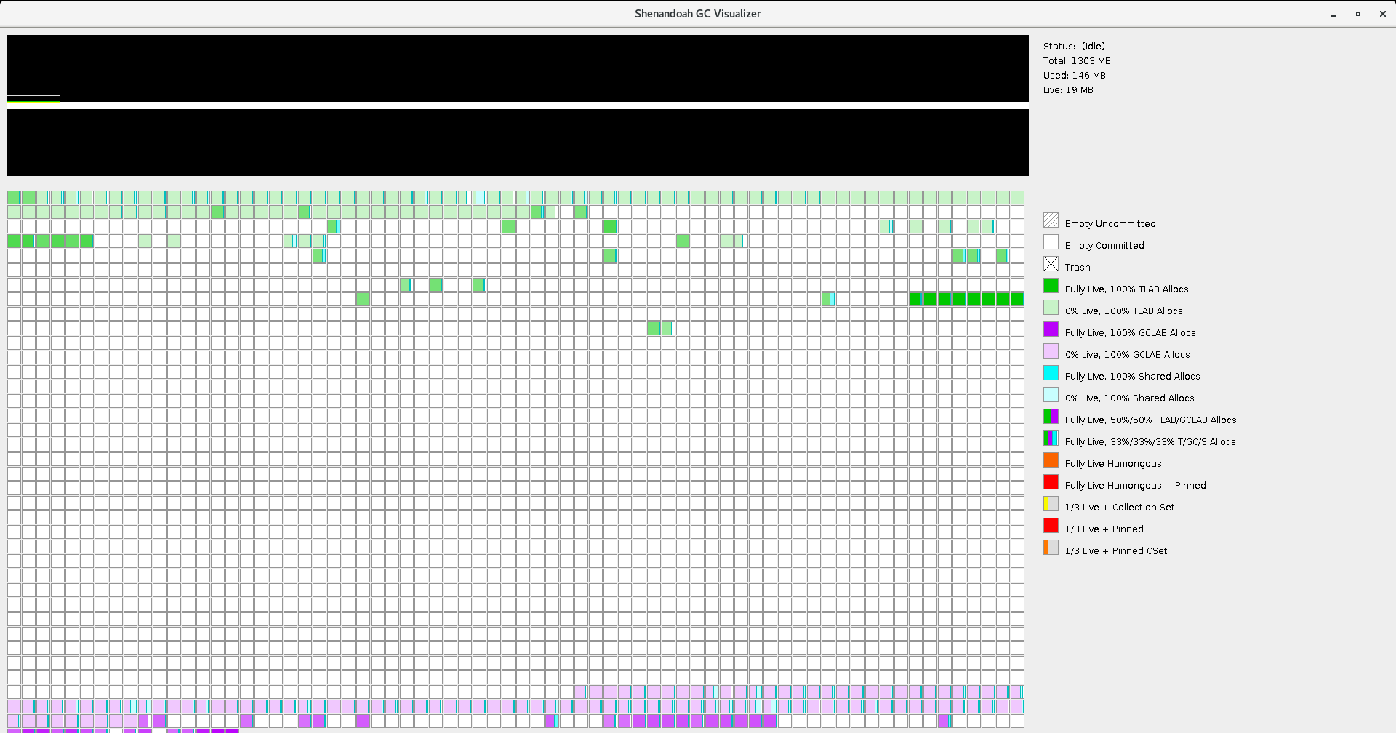
Extra: Shenandoah Visualizer
https://github.com/openjdk/shenandoah-visualizer
java -Xbootclasspath/p:<path-to-tools.jar> -jar visualizer.jar local://<pid>
java -Xbootclasspath/p:/home/penjdk-1.8.0.302./lib/tools.jar -jar visualizer.jar local://85
Notes:
https://github.com/openjdk/shenandoah-visualizer/tree/master/src/main/java/org/openjdk/shenandoah

Slide 22
Relevant Solutions
Shenandoah Tuning
Interpreting Shenandoah logs
Shenandoah Support on OpenJDK
Tuning Shenandoah ShenandoahMinFreeThreshold
G1GC vs Shenandoah
Notes:
Relevant solutions

Slide 23
Fun fact: Shenandoah 1 vs Shenandoah 2
If we can the original paper Shenandoah: An open-source concurrent compacting garbage collector for OpenJDK (written by Christiane H Flood) | JEP 189: http://openjdk.java.net/jeps/189 we see that the actual algorithm is different from the one used currently.
The reason is that the algorithm changed in two main aspects:
Additional word → no more additional word is needed, everything on the mark word
Store barrier → Load barrier
Footprint is not an excuse to use Shenandoah anymore!
Notes:
More as curiosity note here. Yes folks, things have changed and forgot, the footprint of Shenandoah2 is actually smaller compared to ZGC!! Because it uses external tables!

Slide 24
Additional Information
Shenandoah: An open-source concurrent compacting garbage collector for OpenJDK (written by Christiane H Flood)
JEP 189
Main - OpenJDK Shenandoah
CHF’s Presentation in Ticino
Shenandoah-dev list
Incremental update vs SATB

Slide 25
Collection Fun-with-*
ZGC
G1GC
CMS
ParallelGC ← not sure why the overview shows “SerialGC”
SerialGC
C4 GC ← very basic state, much to learn

